Slide 1

Welcome to Our Presentation
We are the Department of Computer Science & Engineering, presenting our survey findings on students’ adoption of scientific and digital tools to enhance educational resources and outcomes.
MEMBERS:
MD. Rahat Hasan Chowdhury (253-15-068)
Anindita Sadat Bristy(253-15-156)
MD. Nafiz Anjum Anik(253-15-178)
MD. Salah Uddin (253-15-232)
Sadia Akhter Mim (253-15-818)
Nusrat Ul Islam Nisa(253-15-850)

Slide 2

Introduction to the Survey
Objective: To understand student adoption and perceptions of scientific/digital tools in academic work.
Scope: Measures frequency of use, self-confidence (CSE), perceived ease of use (PEOU), usefulness (PU), value (PV), social influence (SN), and intention to adopt (IA).
Goal: To identify strengths and gaps in digital tool integration for learning and research.
3

Slide 3

Survey Benefits and Data
Identifies the most frequently used digital tools among students.
Highlights specific areas where students may require additional training or support.
Provides data to help departments improve and allocate digital learning resources effectively.
Informs planning for future laboratory software and IT infrastructure investments.
4

Slide 4

How We Collected the Data?
Form Distribution: Shared through Google Forms, WhatsApp, and class groups for easy access.
Participants: Students from Biochemistry and other science-related departments.
Data Sources: Where responses came from): Food Court, Classrooms, Campus Area, Hall, Online Groups
Privacy: All responses were collected confidentially and anonymously

Slide 5
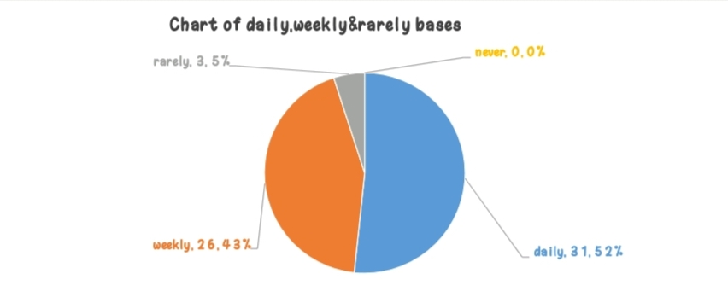
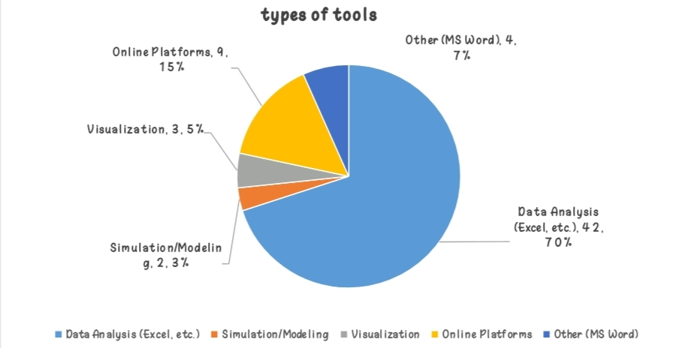
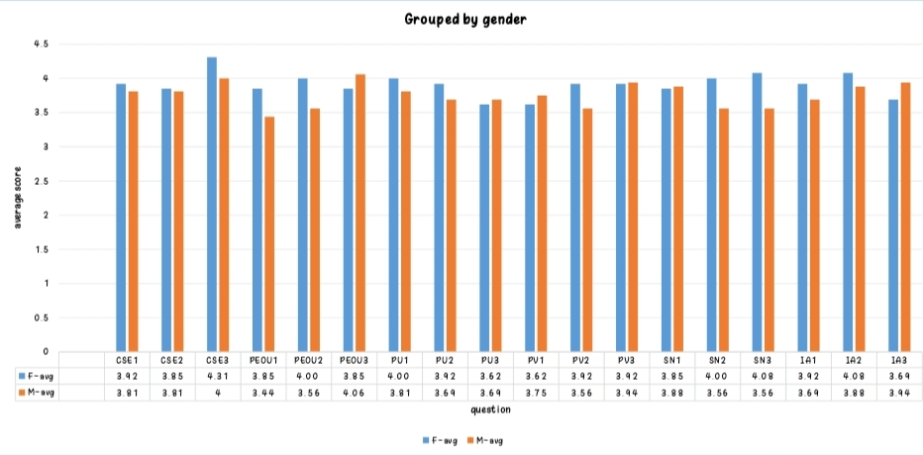
Key Findings
6

Slide 6
How Biochemistry Connects With All Departments
Bridge between Biology & Chemistry
Core to understanding living systems
Pharmacy: Drug action
Nutrition: Digestion & energy
Agriculture: Plant growth & nutrient cycle
Public Health: Disease prevention & vaccines.
6

Slide 7


Conclusion
Insight: Students find digital tools useful and valuable, indicating high readiness for adoption.
Action: Findings will guide targeted training programs to boost confidence (CSE) and ease of use (PEOU).
Collaboration: Strengthens the case for inter-departmental workshops and shared resource portals.

Slide 8

Thank You

